Slide 1
PSYC 4503
Psychological Tests & Evaluations
Course Overview

Slide 2
Who is this person?
Dr. Maxwell
Cognitive Psychologist
  Research interests in memory and language

Slide 3
Contacting Dr. Maxwell
How to contact me:
Email: nicholas.maxwell@msutexas.edu
  Please put course # and section # in header!
  24 – 48 hours (except on weekends)
In person! Office OD 113 (MWF: 9-10am; F: 2-4pm)

Slide 4
What do I get out of this Class?
Provide you with a fundamental understanding of the core issues in psychological testing
Give you the necessary skills to interpret and report psychometric properties of tests and scores
Understand the basics of test development, including item selection and validation of scales

Slide 5
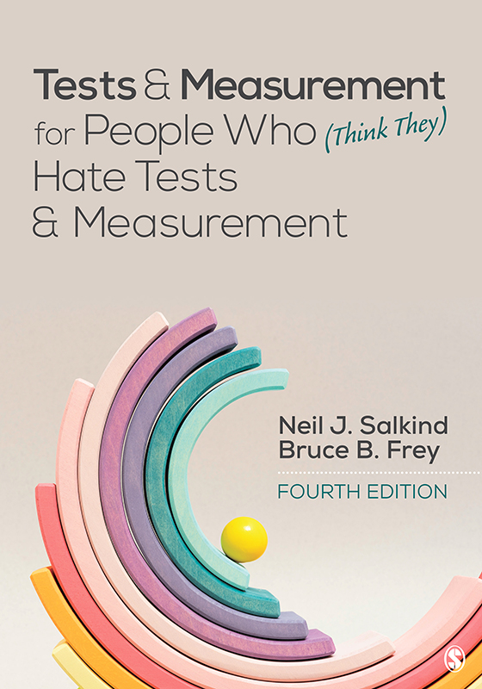
What will I Need?
Textbook: Tests & Measurement for People who Think they Hate Tests and Measurement (4th Edition) by Neil Salking and Bruce Frey
Something to take notes with!

Slide 6
What’s expected of you
3 Exams!
10 quizzes (D2L)
Project!
Participation! (show up and talk!)

Slide 7
Questions?

